Slide 1
Capstone Project - 3
Cardiovascular Risk Prediction by Aashish Thakur Mrityunjay Dubey Satyajit Sahoo

Slide 2
Understanding Problem Statement:
We are given with a data set where one of the variables represent whether a person may suffer from heart disease in next 10 years.
Of size(3390,16)
Our aim is to predict the same.
The target variable is TenYearsCHD and it is binary where:
0 means NO
1 means YES

Slide 3
Variables Involved :
ID
Age
Education
Sex
Is_smoking
Cigs per days
BPMeds
Prevalent stroke
Prevalent Hypertensive
Diabetes
Total Cholestrol
sysBP
diaBP
BMI
Heart Rate
Glucose
Ten Year CHD

Slide 4
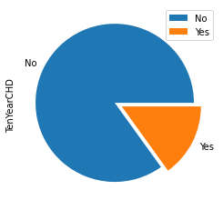
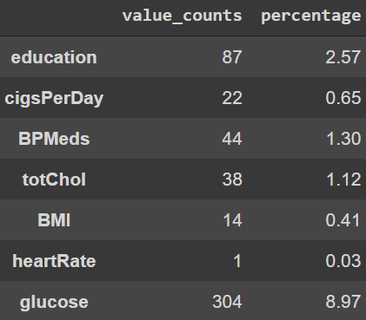
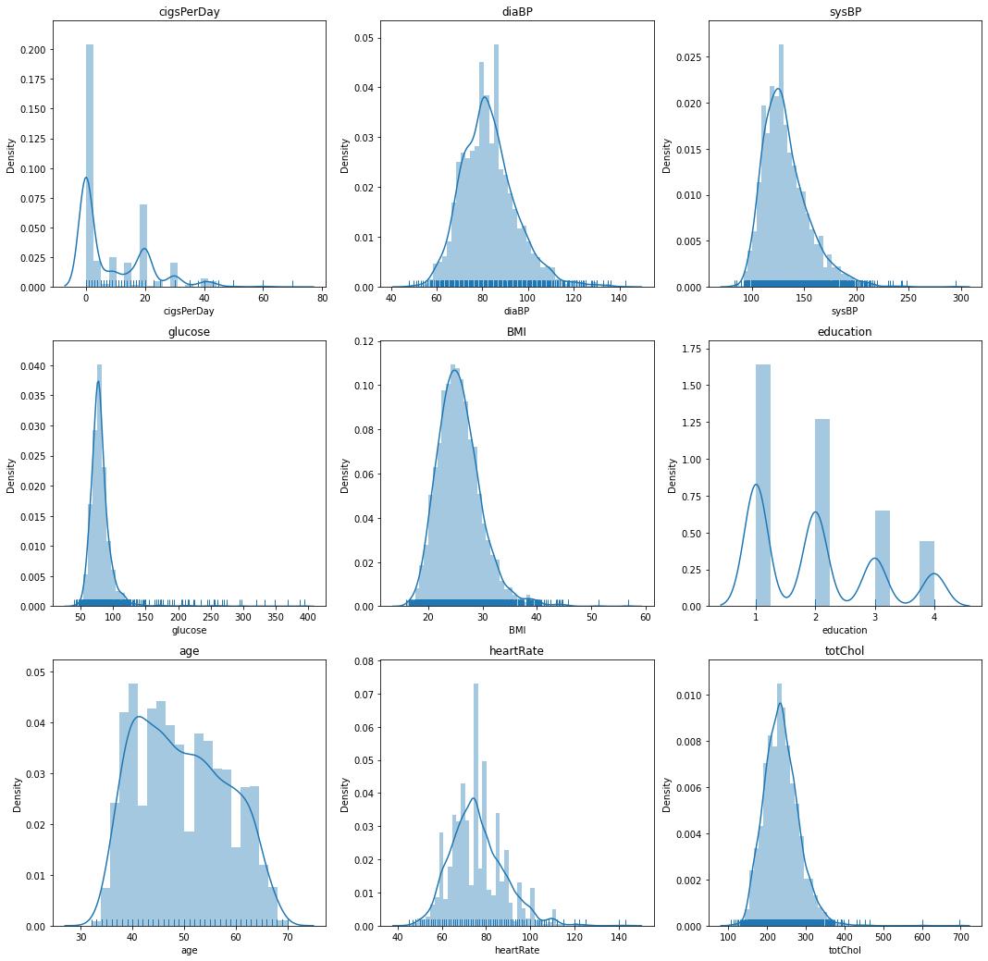
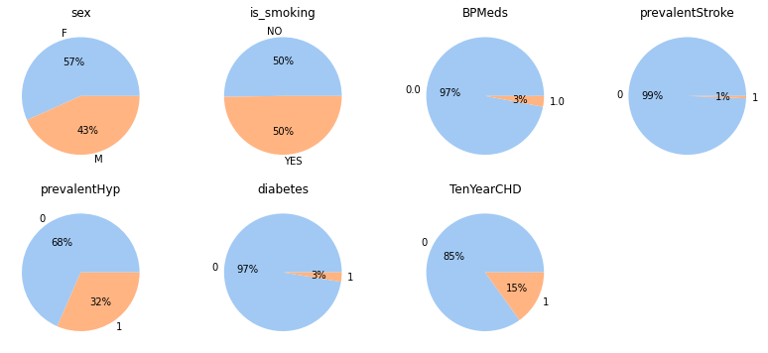
Exploratory Data Analysis :
Null Values
On exploring we see that these variables have null values in them.

Slide 5
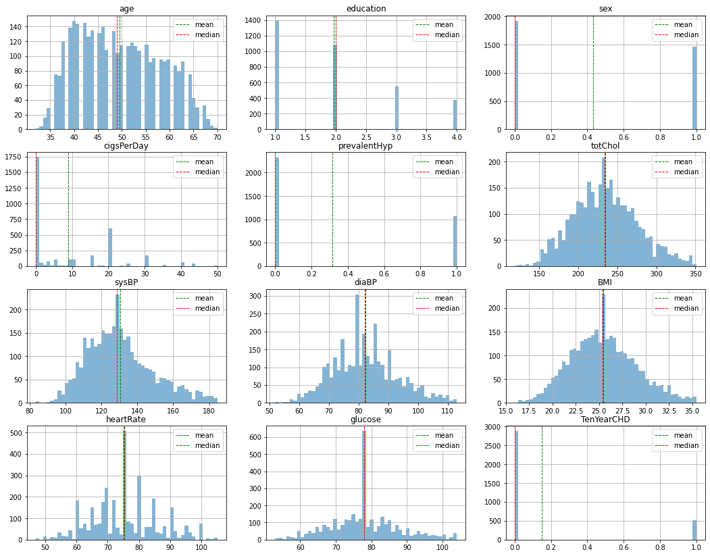

Slide 6
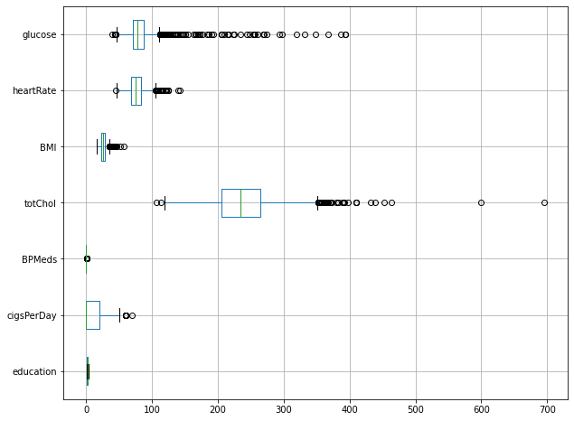
Null-Value treatment
Deciding which value to impute in place of null values.
Mean
Mode
Median

Slide 7
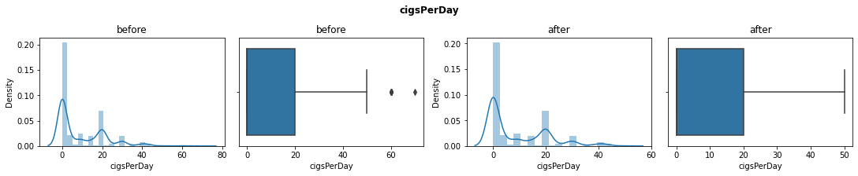
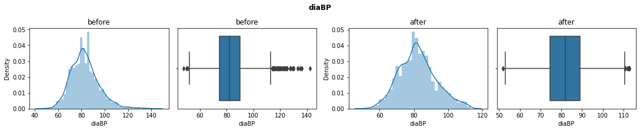
Outlier treatment

Slide 8
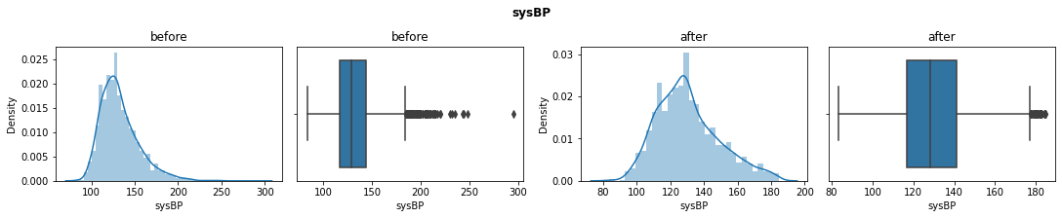
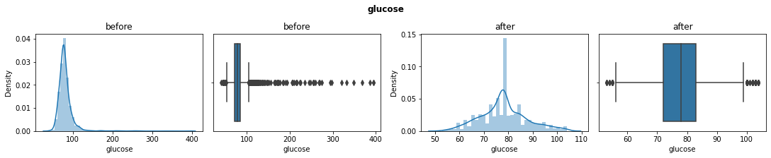
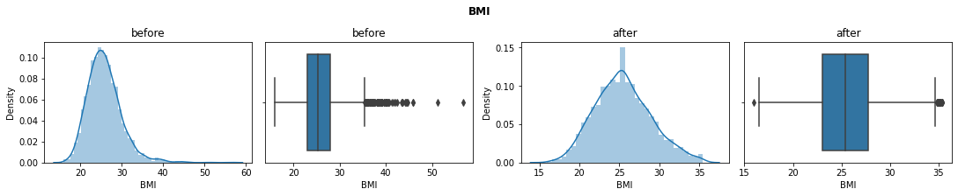

Slide 9
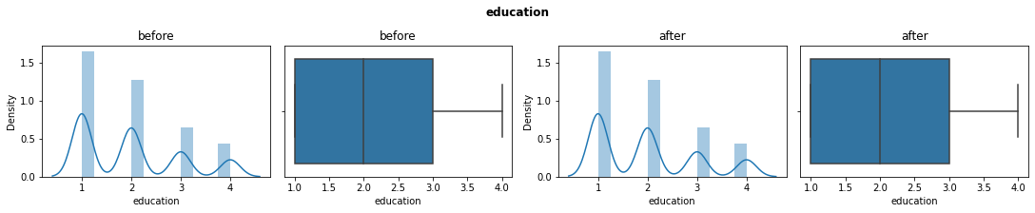
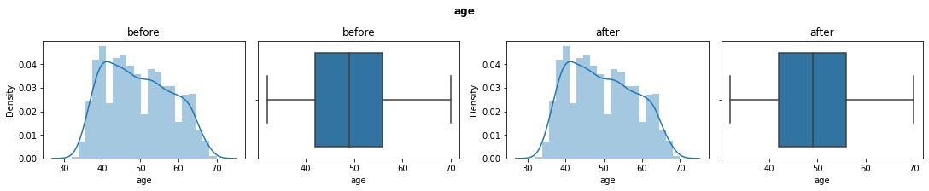
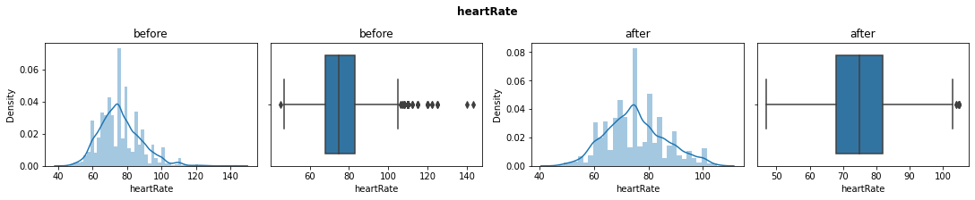

Slide 10
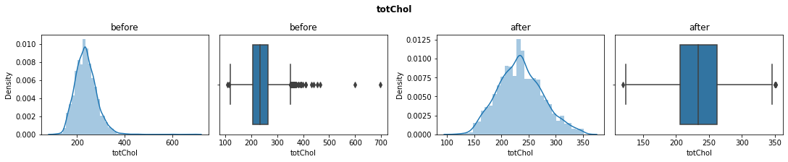

Slide 11
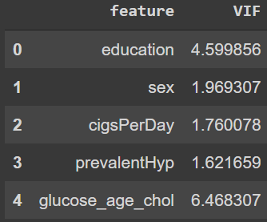
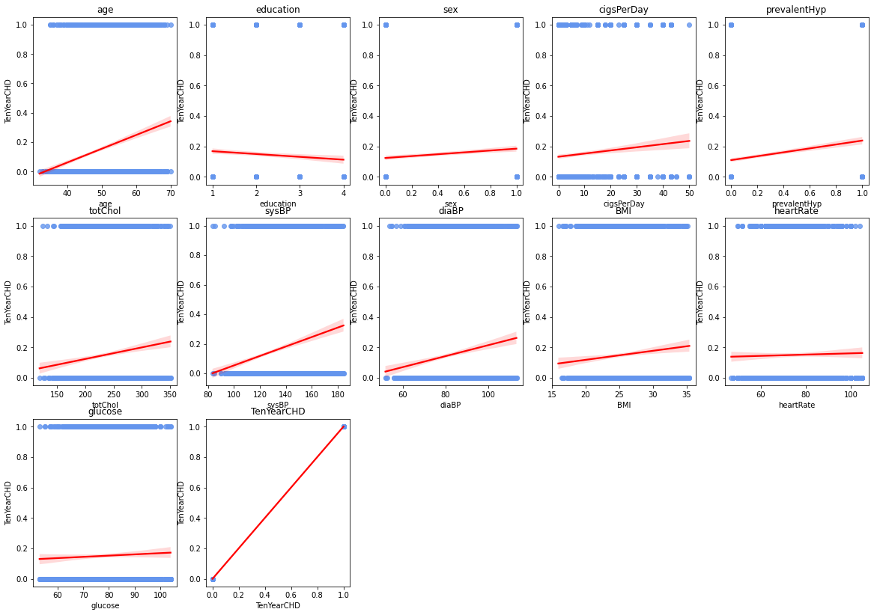
Logistic Regression Data Preparation
Verifying linear dependency
Removing Multicollinearity

Slide 12
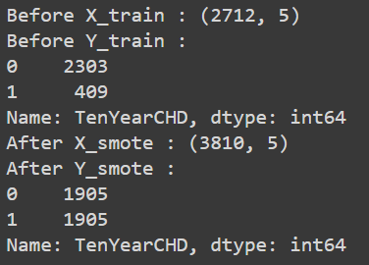
Preparing data for SVCs
Preparing data for Ensemble tree models.
Handling Data Imbalance.

Slide 13
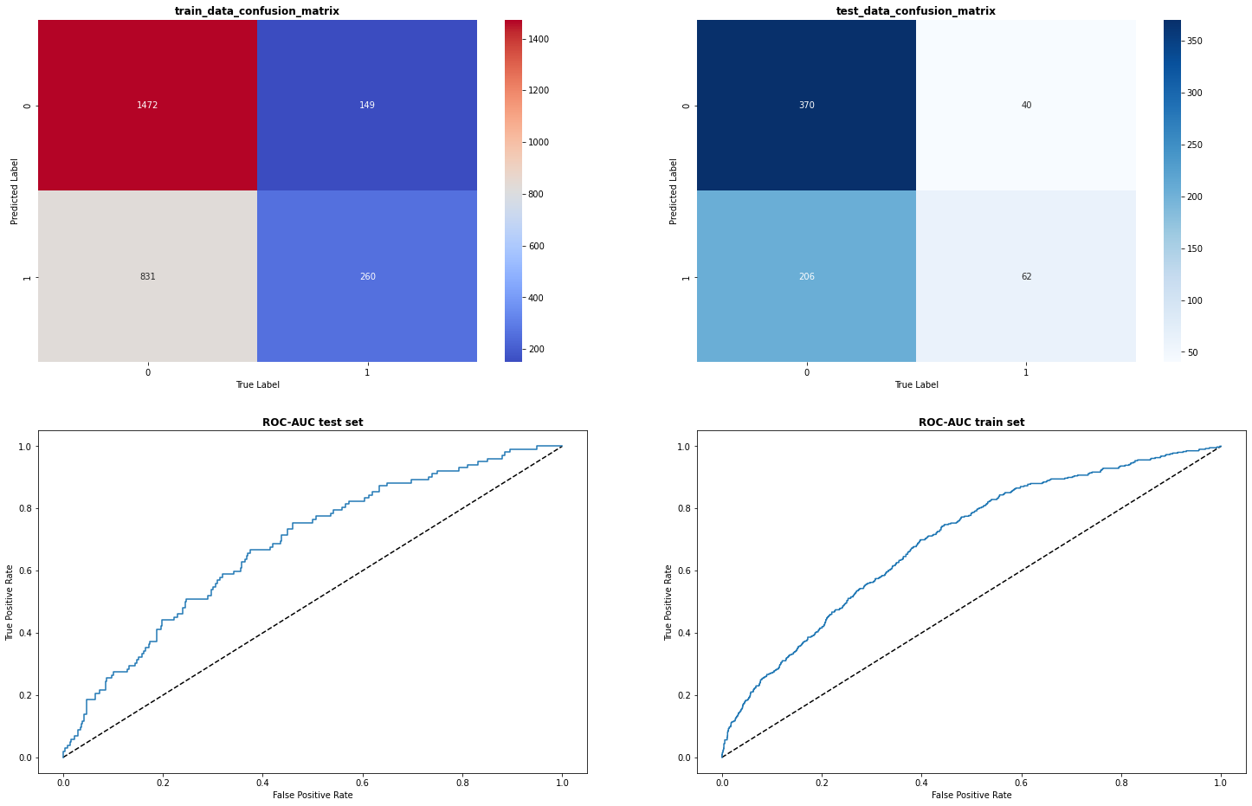
Logistic Regression Implementation

Slide 14
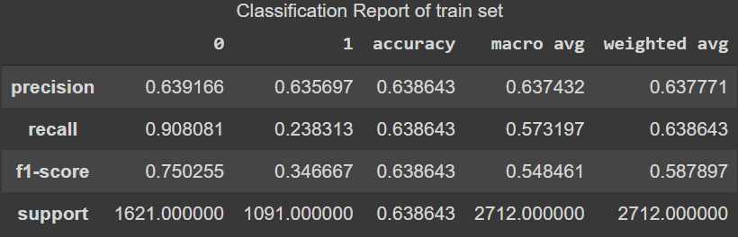
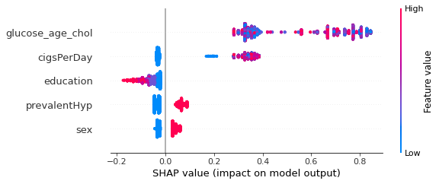
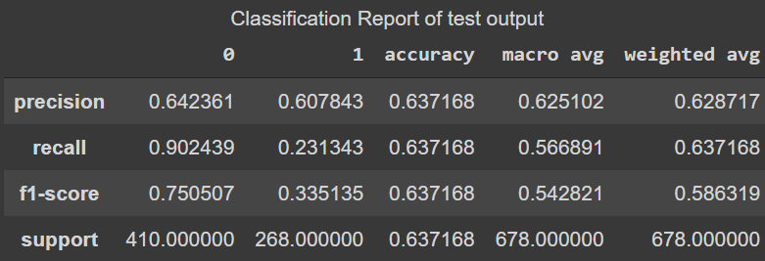
Logistic Regression Implementation (Contd..)

Slide 15
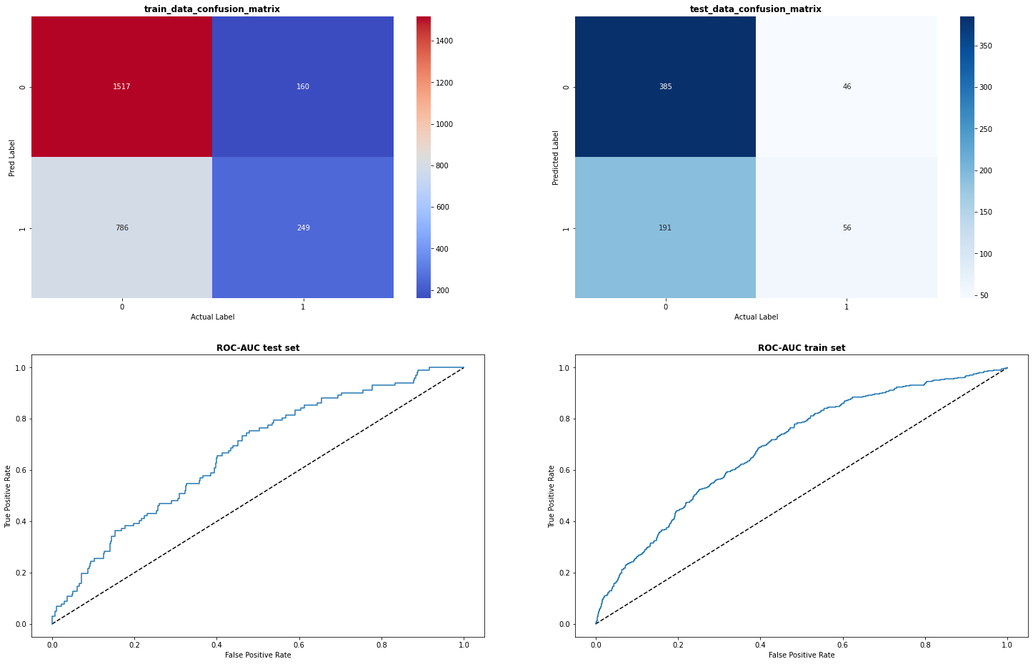
Gaussian Naïve Bayes Implementation

Slide 16
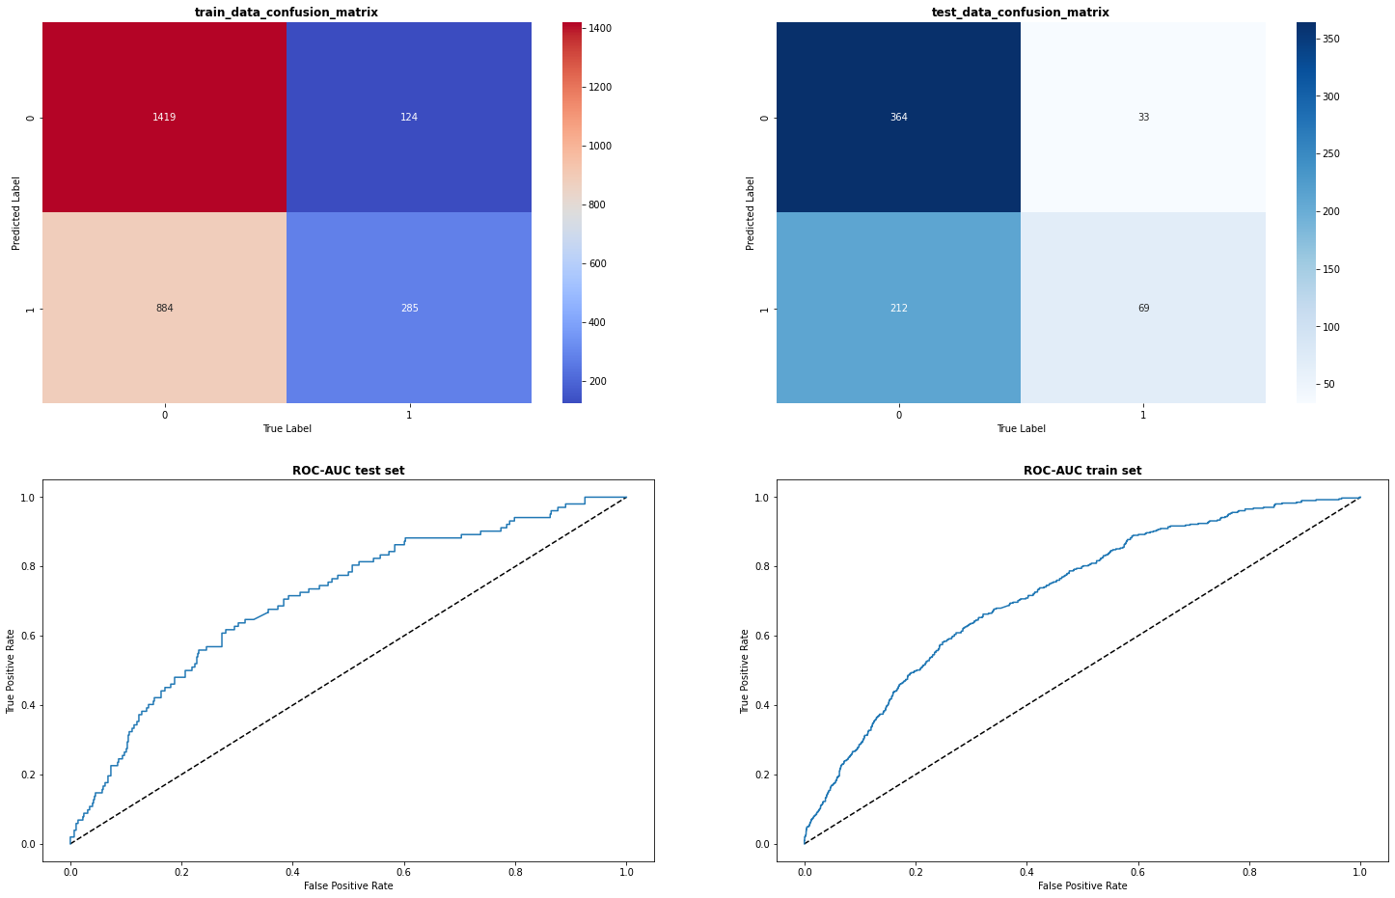
Support Vector Classifier Implementation

Slide 17
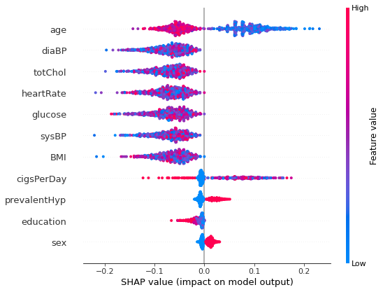
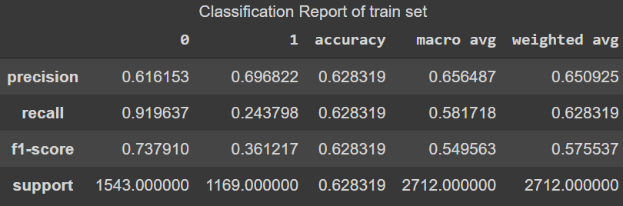
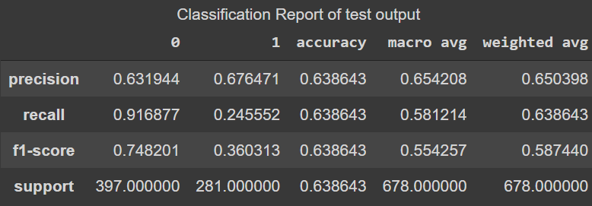
Support Vector Classifier Implementation (Contd..)

Slide 18
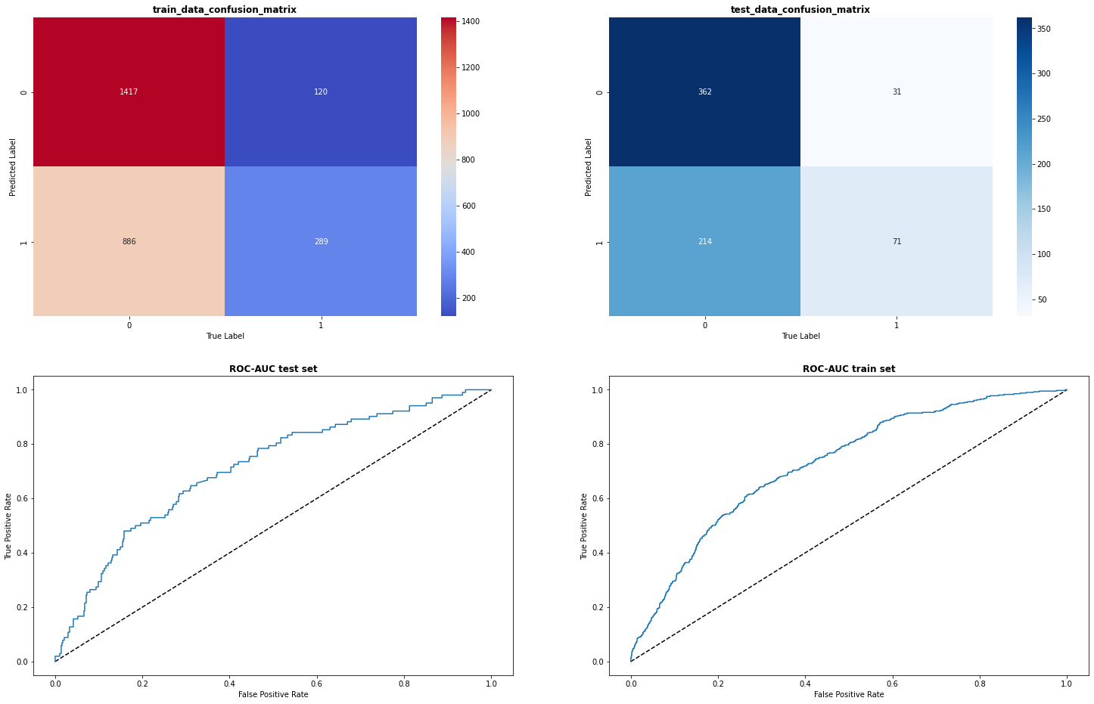
Support Vector Classifier with balanced loss function Implementation

Slide 19
Support Vector Classifier with balanced loss Implementation (Contd..)

Slide 20
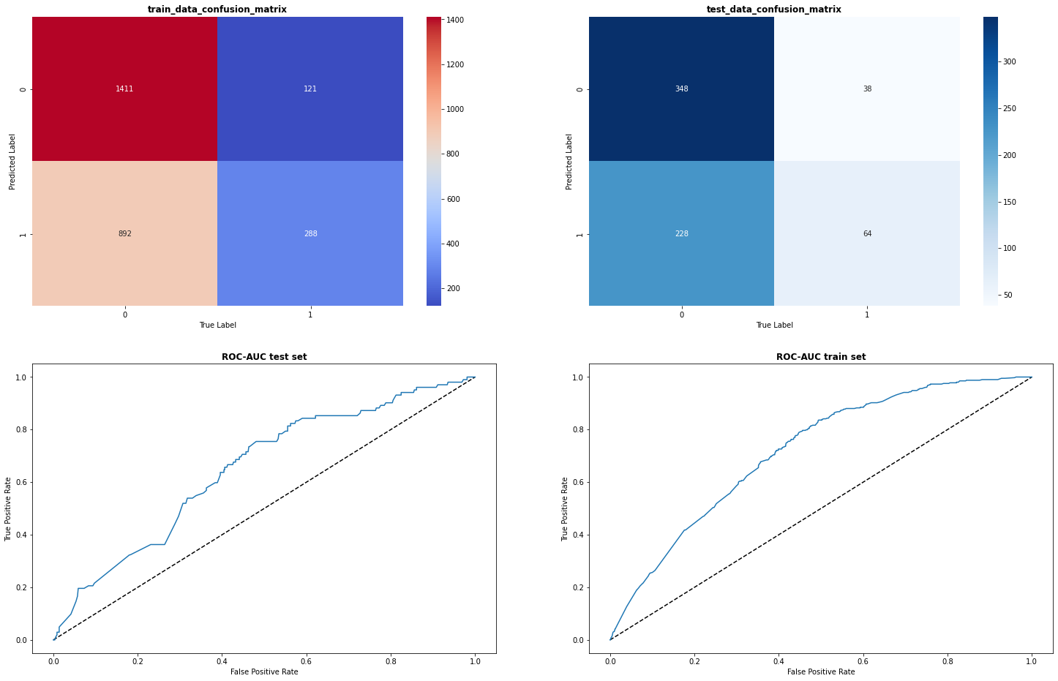
LGBM Implementation

Slide 21
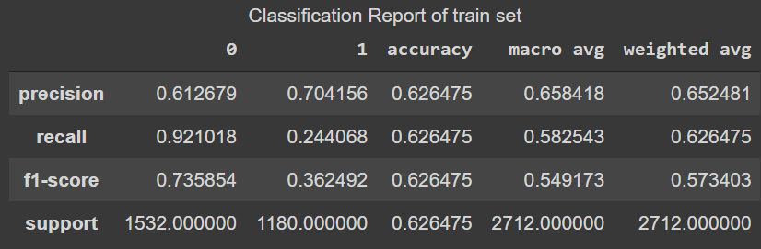
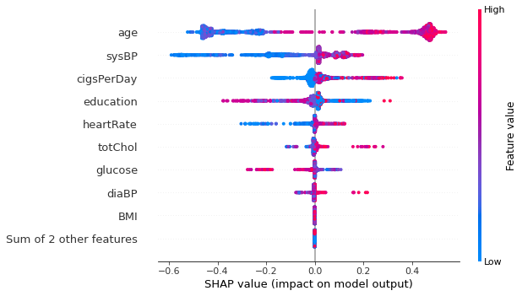
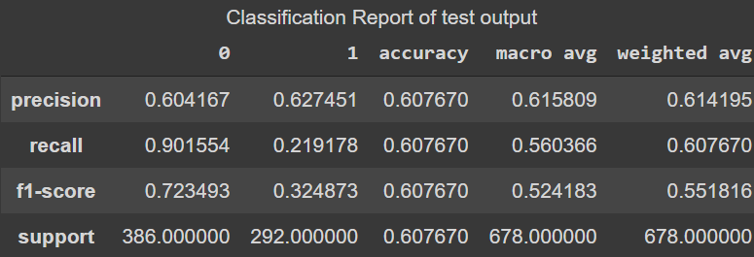
LGBM Implementation

Slide 22
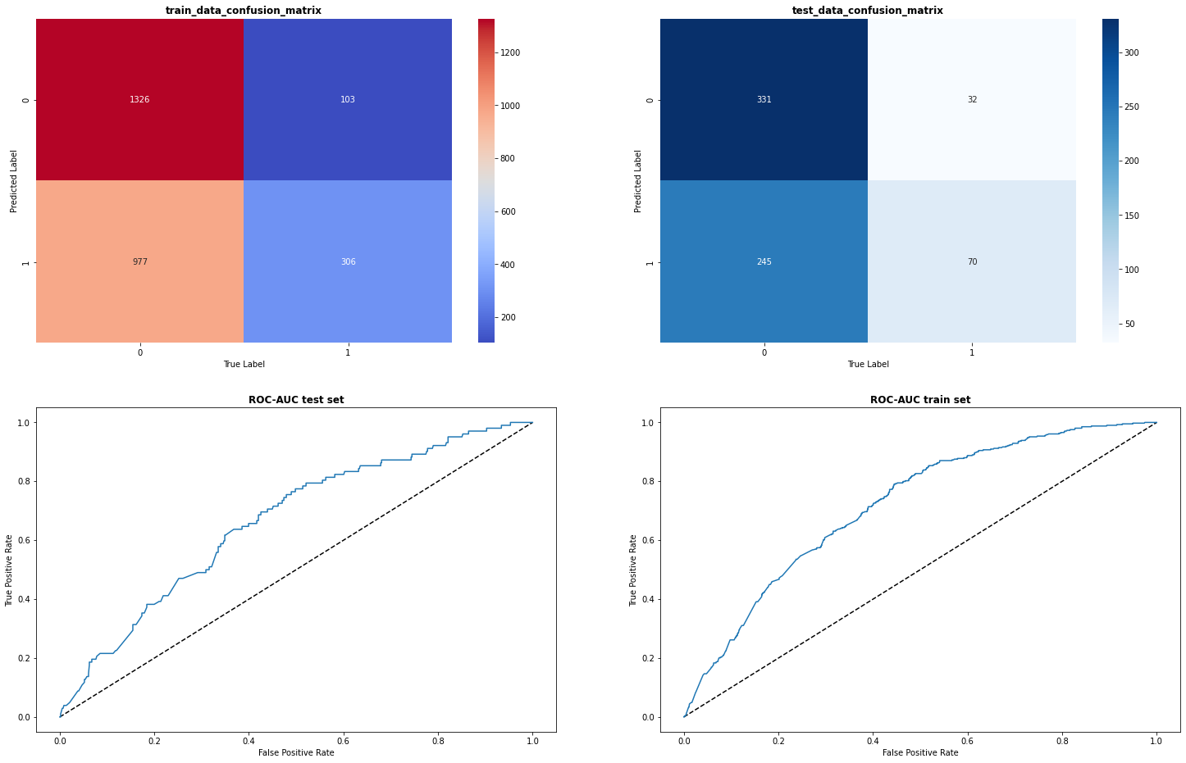
XGRFB Implementation

Slide 23
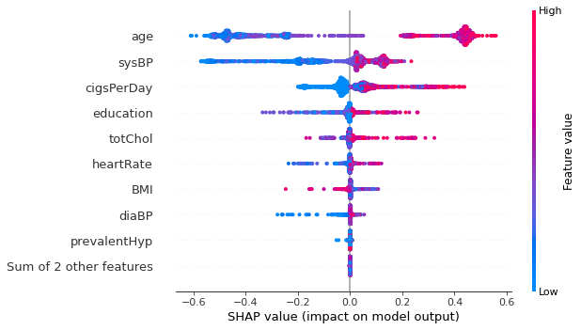
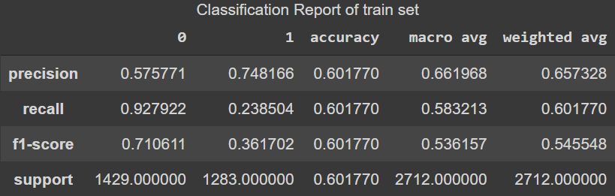
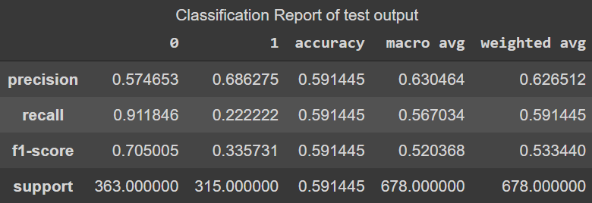
XGRFB Implementation

Slide 24
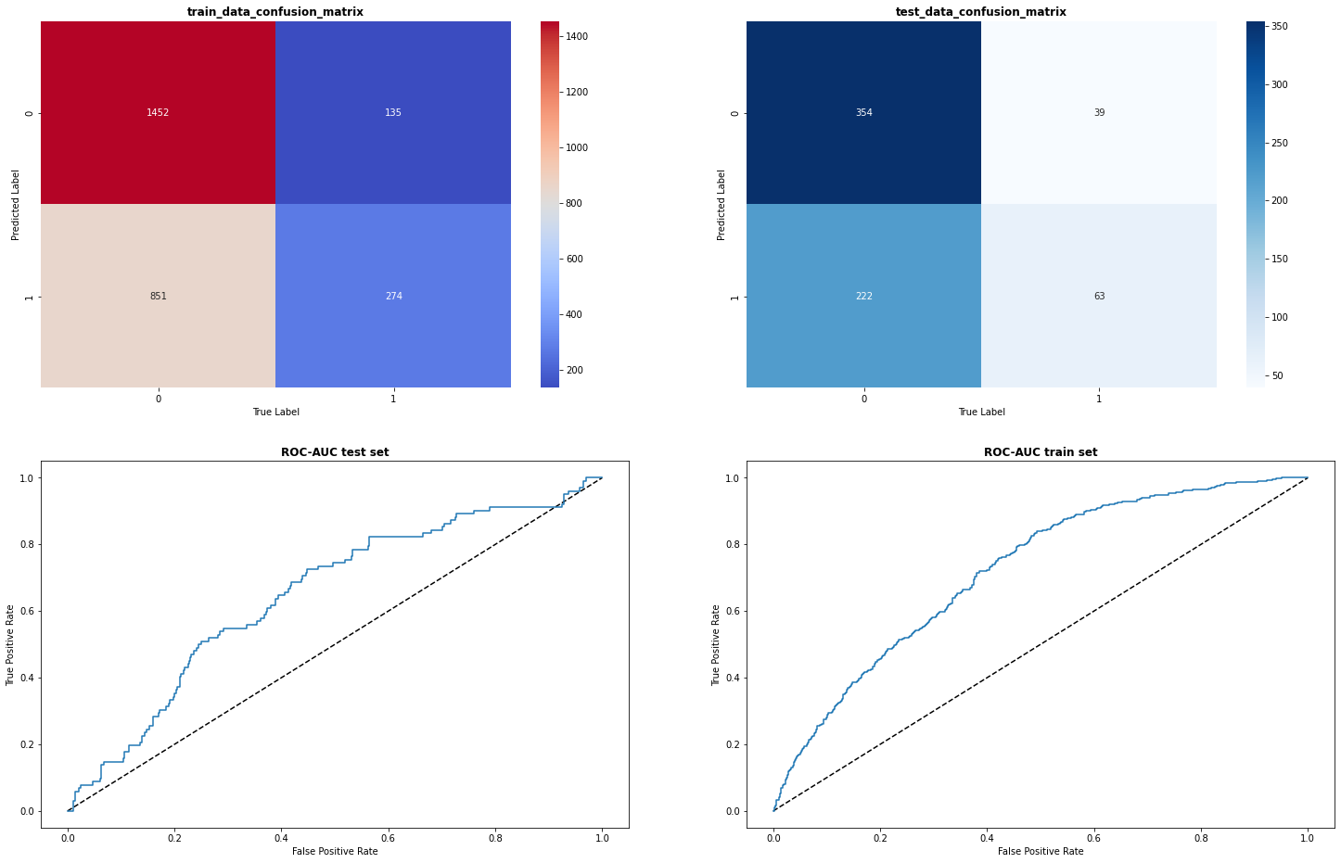
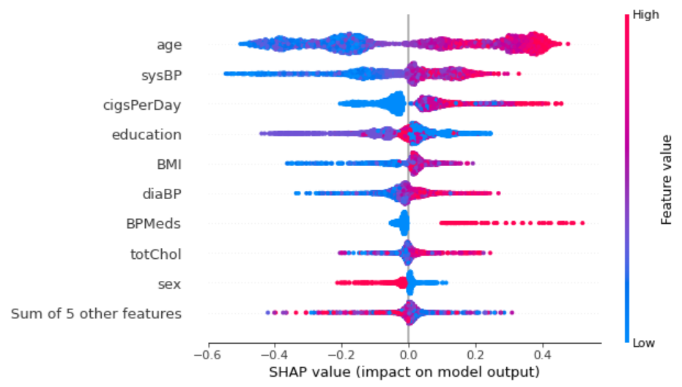
Random Forest Implementation

Slide 25
Neural Network Implementation

Slide 26
Conclusion..
1. Logistic Regression can predict 61% of the negative values long with 35% of False Negative predictions.
2. Gaussian Naive Bayes can predict 55% of the negative values along with 34% of False Negative predictions.
3. Support Vector Classifier (without balanced loss function) can predict 68% of the negative values with 37% of False Negative predictions.
4. Support Vector Classifier (with balanced loss function) can predict 70% of the negative values with 37% of False Negative predictions.
5. LGBM can predict 63% of the negative values with 40% of False Negative predictions.
6. XGRFB can predict 69% of the negative values with 42% of False Negative predictions.
7. Random Forest Model can predict 66% of the negative values with 39 % False Negative predictions.

Slide 27
THANK YOU

